Slide 1
Counting
CSI 219 – Discrete Mathematics

Slide 2
The pigeonhole principle

Slide 3
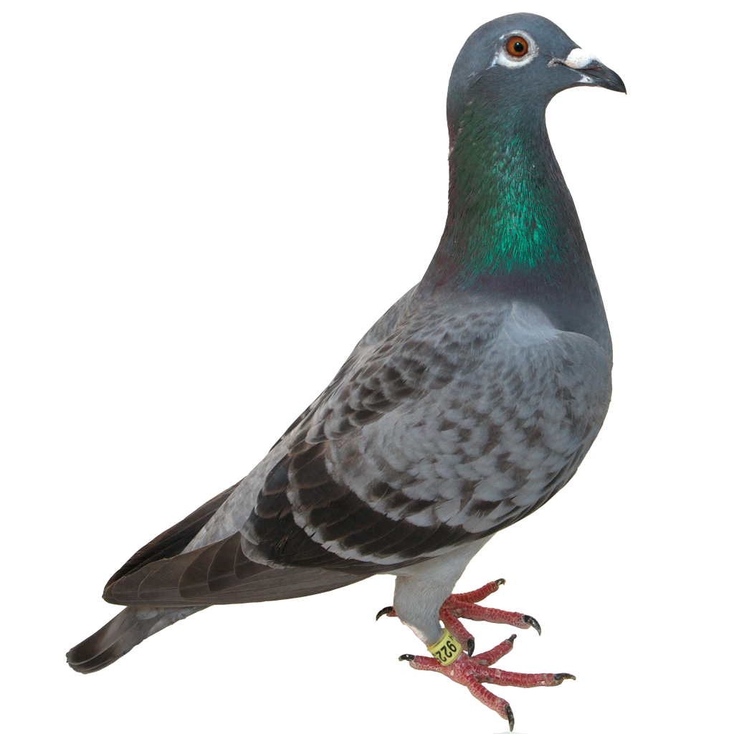
How to place these pigeons?
12 piGEONholes
13 pigeons

Slide 4
How to place these pigeons?

Slide 5

The pigeonhole principle
If $k$ is a positive integer, and $k+1$ or more objects are placed into $k$ boxes, then there is at least one box that contains two or more objects

Slide 6
Example
How many students must be in a class to guarantee that at least two students receive the same score on the final exam, if the exam is graded on a scale from 0 to 100 points?

Slide 7

Generalized pigeonhole principle
If $N$ objects are placed into $k$ boxes, then there is at least one box containing at least $\left\lceil \frac{N}{k}\right\rceil$ objects

Slide 8
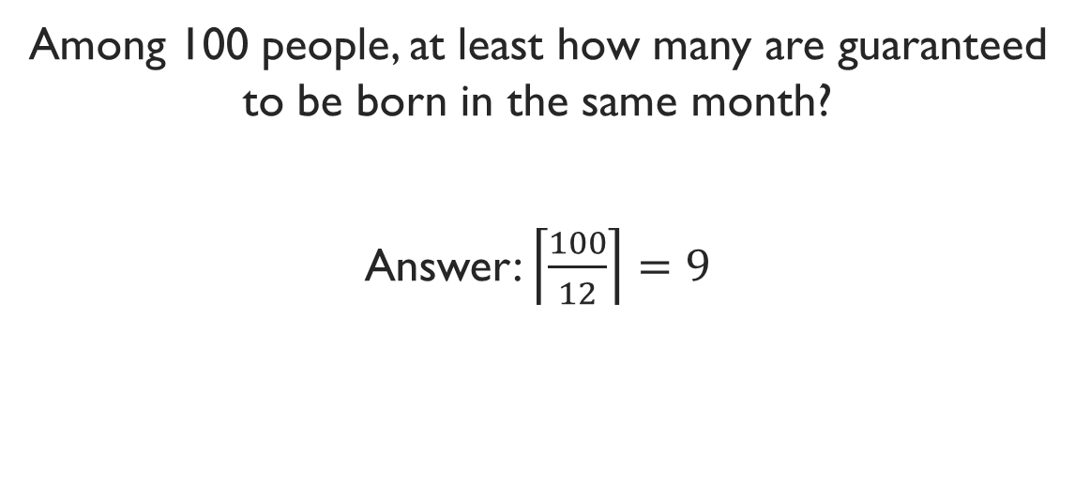
Example
Among 100 people, at least how many are guaranteed to be born in the same month?
Answer: $\left\lceil \frac{100}{12}\right\rceil =9$

Slide 9
Example
What is the minimum number of students required in a discrete mathematics class to be sure that at least six will receive the same grade, if there are five possible grades, A, B, C, D, and F?

Slide 10
Exercise
How many cards must be selected from a standard deck of 52 cards to guarantee that at least three cards of the same suit are chosen?

Slide 11
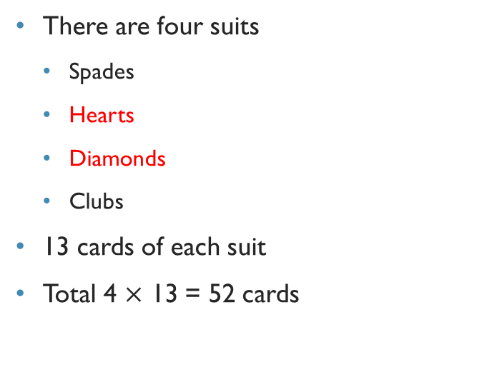

Cards tutorial

Slide 12
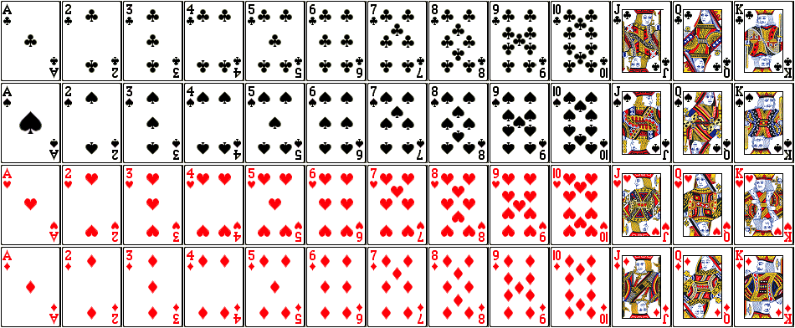

Slide 13
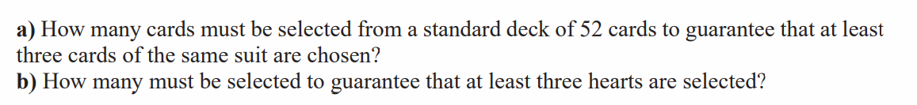
Exercise

Slide 14
Exercise
A drawer contains a dozen brown socks and a dozen black
socks, all unmatched. A man takes socks out at random in the dark.
a) How many socks must he take out to be sure that he
has at least two socks of the same color?
b) How many socks must he take out to be sure that he
has at least two black socks?

Slide 15
Exercise
Telephone number format: NXX-NXX-XXXX, where N = 2 to 9, X = 0 to 9
The first three digits form the area code
25 million people in the state
At least how many area codes needed?

